Slide 1

Optimal Cislunar Trajectories with Continuous, High-Thrust Nuclear-Thermal Propulsion
Erik Payton, Colby Merrill, Mason Peck, and Dmitry Savransky
Cornell University
January 6th, 2025
Notes:
Name and Introduction...you got this!!!

Slide 2
Outline
Background & Motivation
Research Methods
Case Study Results
Conclusion

Slide 3
Outline
Background & Motivation
Propulsion and Trajectories
Minimum Time Transfers
NTP Overview
Research Methods
Case Study Results
Conclusion

Slide 4
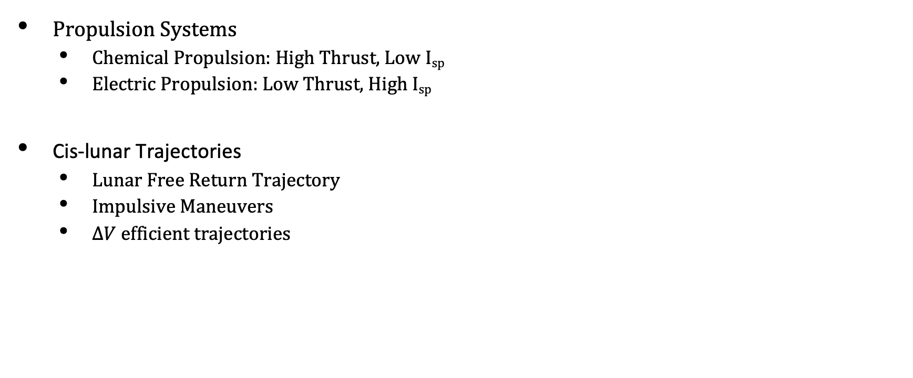
Background
Propulsion Systems
Chemical Propulsion: High Thrust, Low I_{sp}
Electric Propulsion: Low Thrust, High I_{sp}
Cis-lunar Trajectories
Lunar Free Return Trajectory
Impulsive Maneuvers
$ΔV$ efficient trajectories
Notes:
1) Prop systems
- What is Isp
- Chemical
- Electric
2) Cis-Lunar Trajectories
- We want minimum fuel trajectories
- Impulsive (Hohmann Transfer)
- Lunar Free Return -- Apollo
What if we didn't care about these... :)

Slide 5
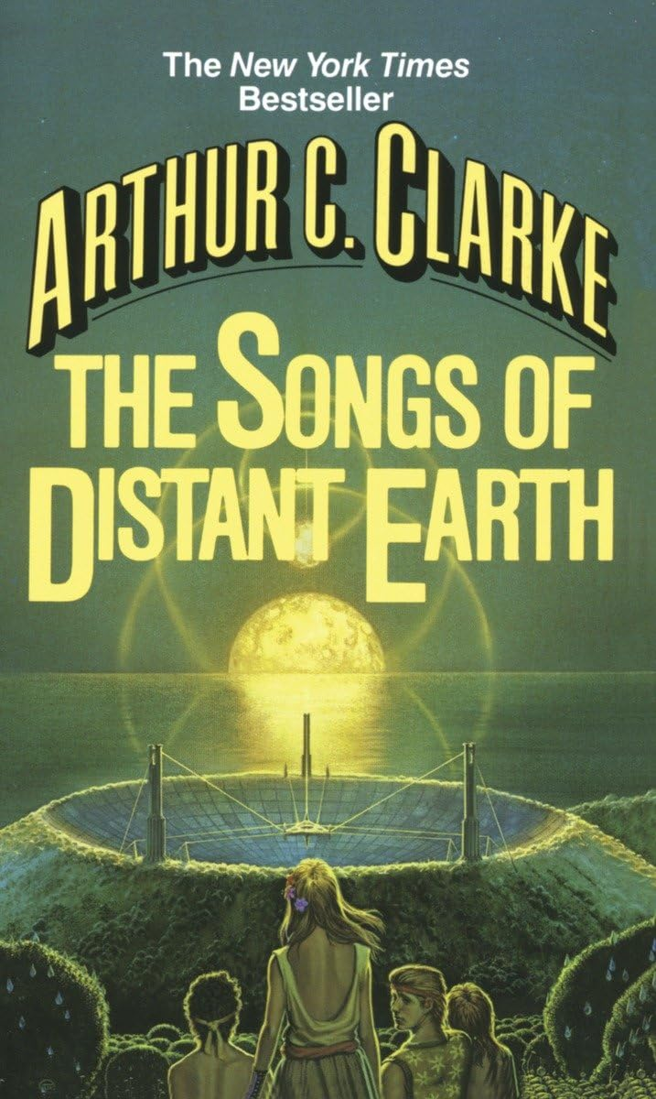
Background: Minimum Time Trajectories
“Turn and Burn” Trajectory
Minimize the Time-of-Flight Maneuver
Satisfies Hamilton-Jacobi-Bellman Time optimality
Continuous-High-Thrust Maneuver
Not feasible outright with current technologies
[1]
[1] Clarke, Arthur C. The Songs of Distant Earth. New York: Del Rey Books, 1986.
Notes:
Now we have a min time...aka turn and burn
1) Songs of Distant Earth
- Journey of the spaceship Magellan
- It uses a similar type of Maneuver
2) What does a Min time mean:
- Satisfies the Hamilton Jacobi Bellman time optimality
- Fastest transit method = accel then decell
- Current Tech is too limited in the Isp-Thrust space to capitalize on the major benefits of this type of maneuver

Slide 6
Background: NTP Technology
Nuclear Thermal Propulsion
Expand a working fluid (e.g. Hydrogen) using a small fission reactor
800s – 1000s Isp
Two large pitfalls
Larger Engine Mass
Non-negligible ramp times
[2]
Specification | NTP | Chemical
Thrust Class | 66,700 N | 66,700 N
Isp | 900 s | 451 s
Total Engine Mass | 4550 kg | 510 kg
Total Engine Length | 5.0 m | 2.3 m
Total Engine Diameter | 1.9 m | 1.9 m
[2] Harnack, C., Grella, E., Greenhalge, S., and Duchek, M., “Capabilities of Sinlge Launch NTP and Chemical Spacecrafts for Cis-Lunar Tug Missions,” Nuclear and Emerging Technologies for Space, 2023.
Notes:
1) NTP offers a new "middle of the road" technology
- High thrust capabilities
- High (ish) Isp
- How it works
2) What are the pitfalls
- Engine mass: The thrust per mass is much lower than chemical systems
- Non-neglagible ramps on the second slide--after some background

Slide 7
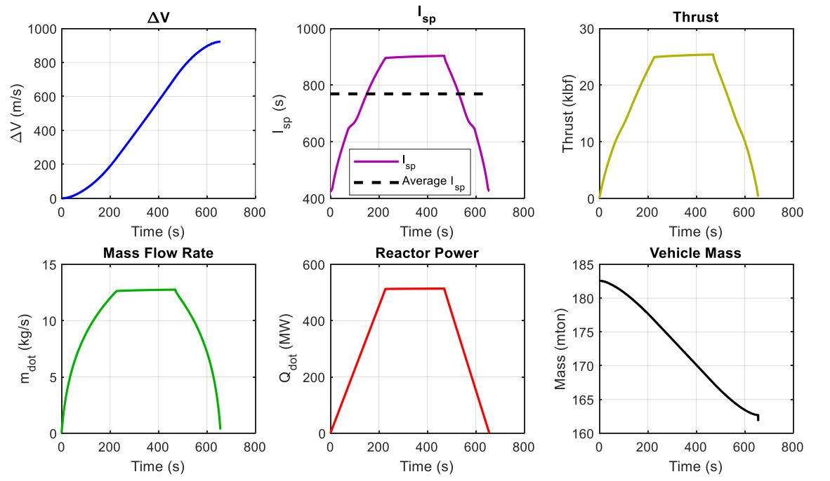
Motivation: NTP and Turn and Burn
No ramp time hinderance on efficiencies
Continuous Thrust would require less thrust magnitude so the engine would be smaller, reducing mass
NASA Artemis System [4]
26.6 kN Thrust (Service Module)
~15,000 kg Mass (Service Module)
Cont. Thrust
300-400 N Thrust
20,000 kg Spacecraft
98% Decrease in thrust compared to Impulsive
15-20% Increase in I_{sp} Compared to NTP impulsive
[3]
[3] Duchek, M. E., Nikitaeva, D., Harnack, C., Grella, E., and Greenhalge, S., “Parametric Modeling of NTP Engine Performance for a Crewed Mars Mission,” ASCEND 2023, 2023.
[4] Bowman, A., Peters, E., “Orion Components”, NASA 2024
Notes:
1) Ramp inefficiencies
- order 200 s ramp times
- in an impulsive operational paradigm, avg is not the same as peak
2) What Continuous Thrust
- If continuously burning, smaller engine mass needed
- good considering the high mass cost
- Scaling information in backup
- the ramp times become negligible and avg approaches peak

Slide 8
Outline
Background & Motivation
Research Methods
Assumptions
Dynamics
Numerical Methods
Case Study Results
Conclusion

Slide 9
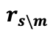
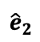
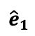
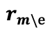
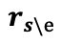
Assumptions
Spacecraft considered in the Earth-Moon system
Spacecraft Parameters
Specific Impulse: 1000s
Wet Mass: 20,000 kg
Propellent Mass: 9,000 kg
Orbital Parameters
Starting Orbit: GEO
Target Lunar Orbit: LLO
1 DU = 384,400 km (a_{moon})
Spacecraft
$$r_{s\backslash m}$$
$$r_{s\backslash e}$$
Moon
$${\hat{e}}_{2}$$
Earth
$$r_{m\backslash e}$$
$${\hat{e}}_{1}$$
Notes:
Located in the Earth-Moon system
1) Spacecraft Parameters
2) Orbital parameters
3) Diagram - note the 3 vector quantities

Slide 10
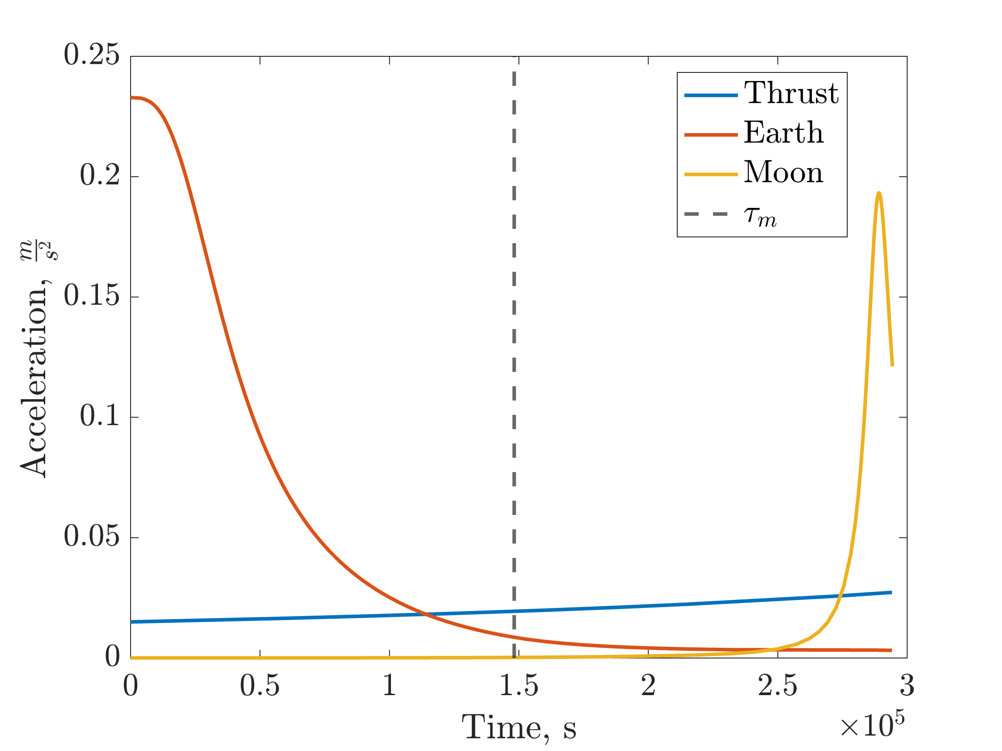
Dynamics
Gravitational interactions with Earth and Moon
Ephemeris Model
Force from propulsion system aligned with velocity vector
Earth Dynamics Lunar Dynamics Thrust
For Numerical Stability at Zero Velocity
Maneuver Flip time
Notes:
1) Modeling
- 3 accelerating terms: Earth, Moon, Propulsion system
- Ephemeris Model, using NAIF's Spice (Mice) package
2) Equation
- first 2 are standard newton gravity
- Thrust: fires along velocity direction, flip at tau_m
- 0.2 for numerical stability
3) Plot
- Magnitude plot
- Earth and moon domination sections
- Vertical flip time marking

Slide 11
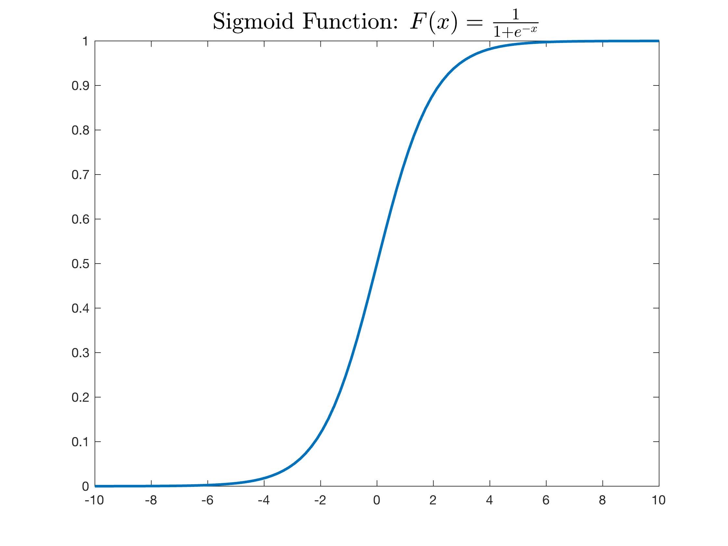
Numerical Methods
Adams-Bashforth-Moulton predictor-evaluator-corrector-evaluator solver
Max/Min orders of 13 and 1
Tolerances of 1 x 10⁻¹¹
Nelder-Mead simplex algorithms described in [5] Lagarias et al, 1998
Optimality achieved by minimizing the cost function
Integrated Time Boundary Value Problem: Radial Position Boundary Value Problem: Eccentricity
Notes:
1) Discuss the Set-Up
- Numerical Propagation of Dynamics wrapped in Optimizer
2) Cost Function
- BREIF overview
- Integrated term
- BVP Terms
- Sigmoid

Slide 12
Outline
Background & Motivation
Research Methods
Case Study Results
Conclusion

Slide 13
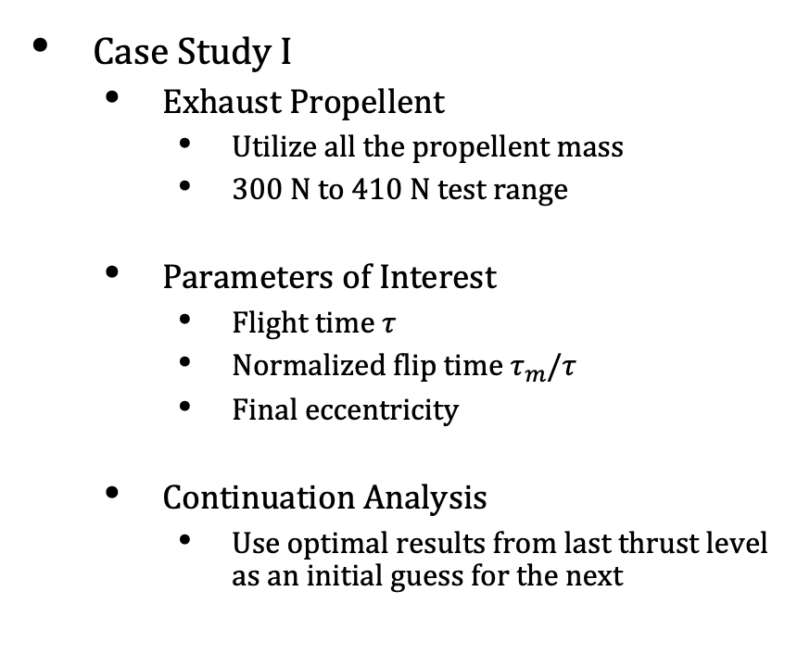
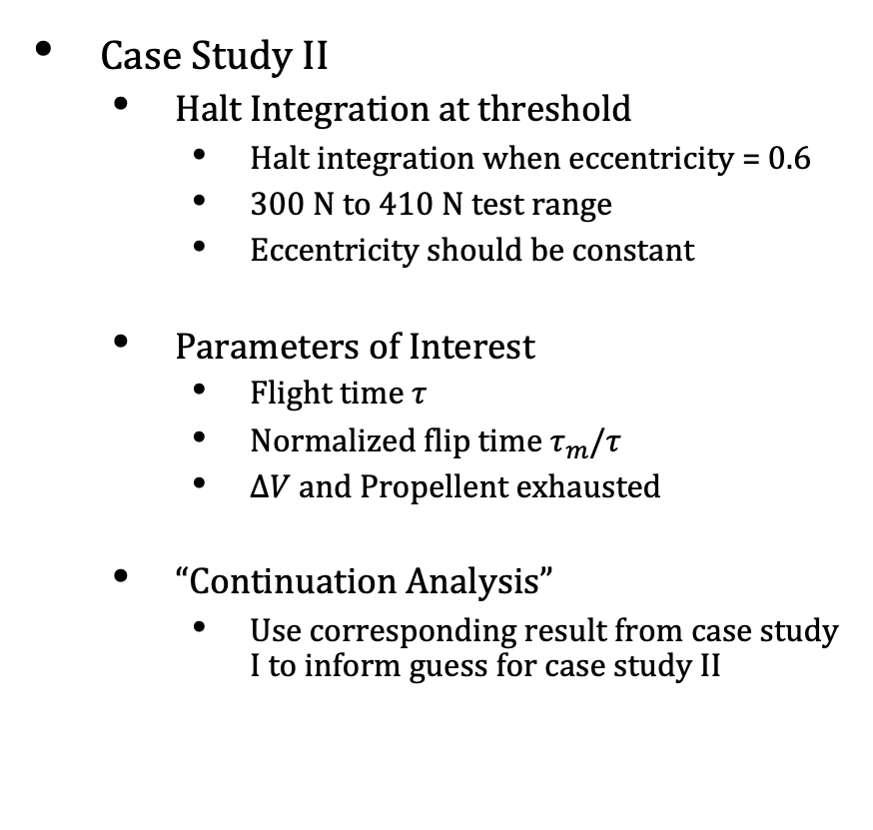
Results
Case Study I
Exhaust Propellent
Utilize all the propellent mass
300 N to 410 N test range
Parameters of Interest
Flight time $τ$
Normalized flip time $τ_{m}/τ$
Final eccentricity
Continuation Analysis
Use optimal results from last thrust level as an initial guess for the next
Case Study II
Halt Integration at threshold
Halt integration when eccentricity = 0.6
300 N to 410 N test range
Eccentricity should be constant
Parameters of Interest
Flight time $τ$
Normalized flip time $τ_{m}/τ$
$ΔV$ and Propellent exhausted
“Continuation Analysis”
Use corresponding result from case study I to inform guess for case study II
Notes:
Both)
- Talk about the main goals
- Parameters of Interest
- Continuation Analysis

Slide 14
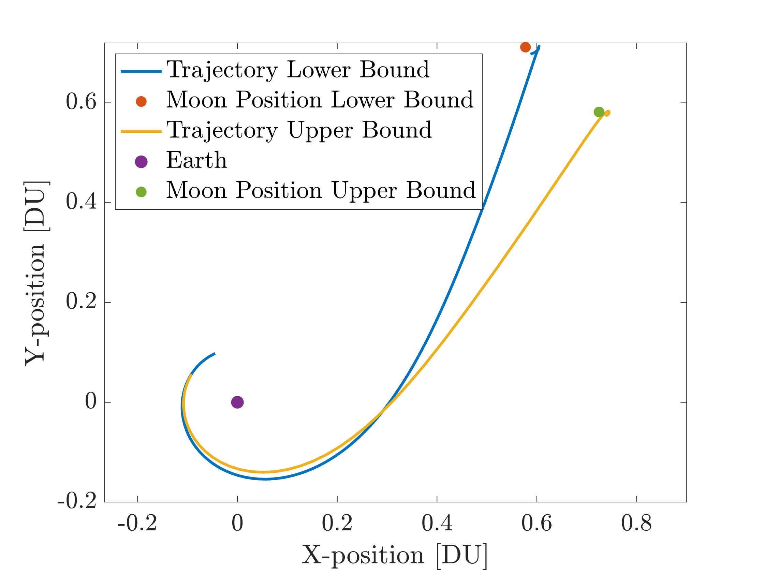
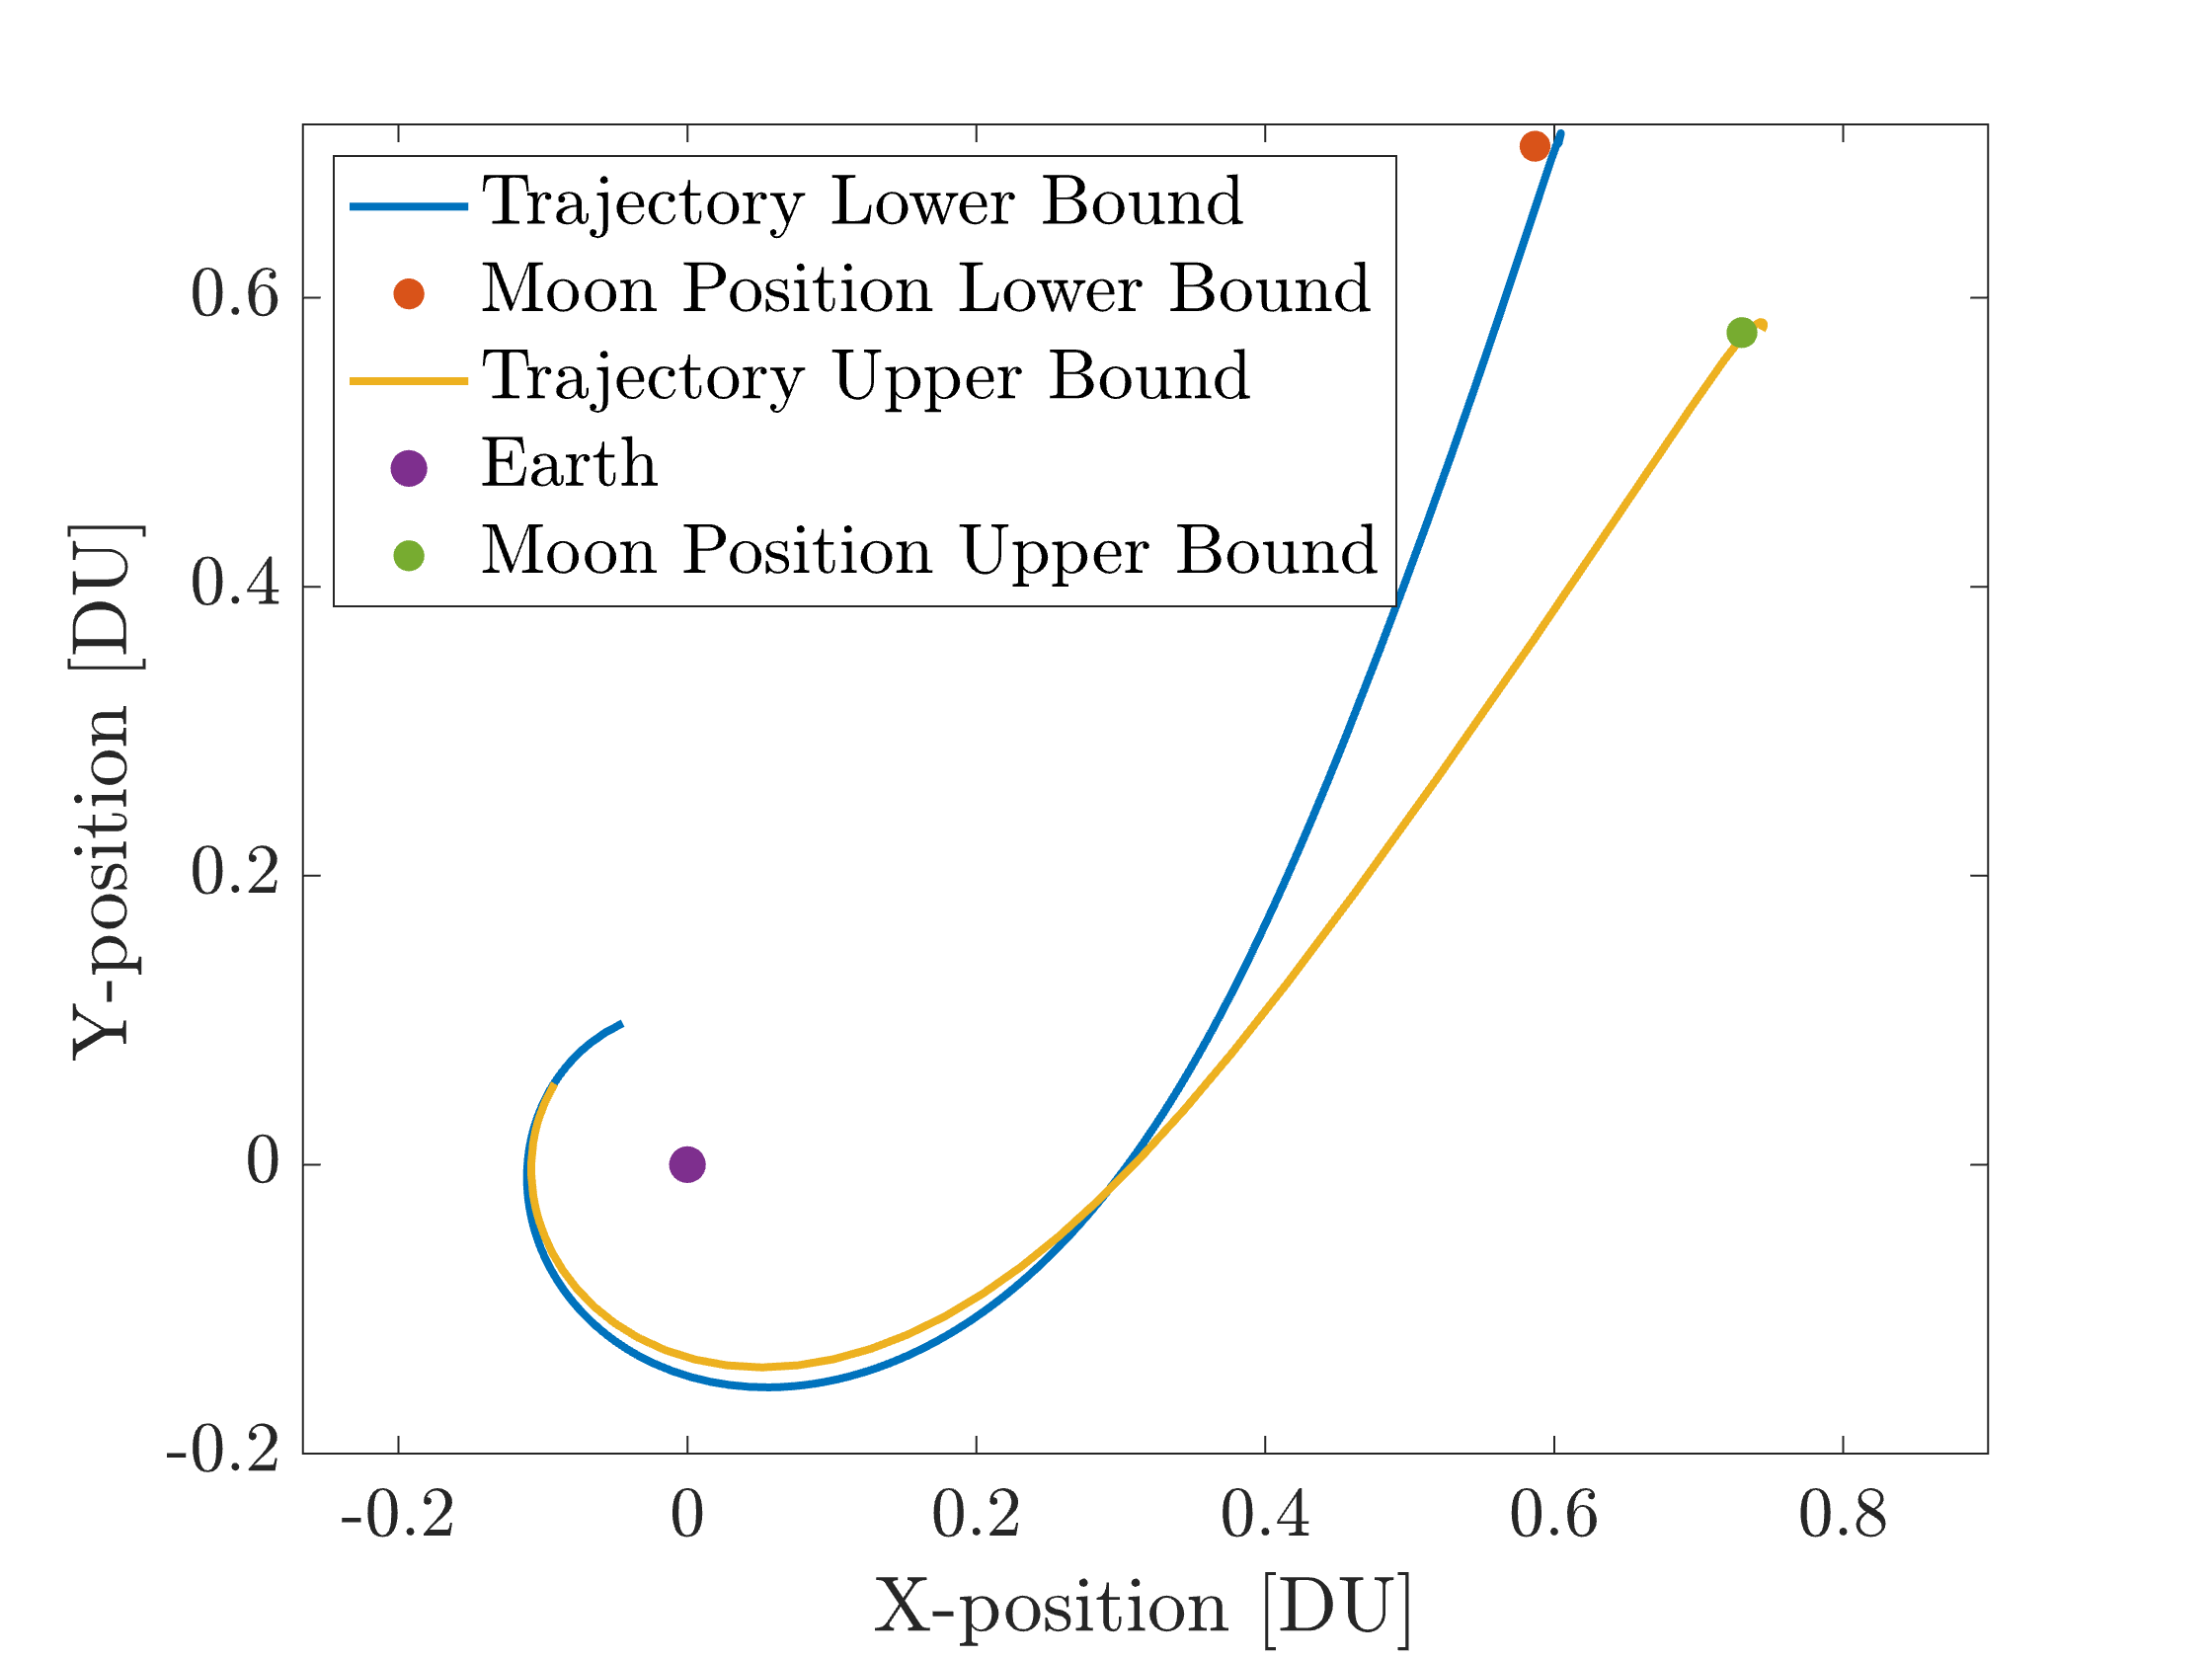
Trajectory Bounds
Case Study 1
Case Study 2
Notes:
Leading Edge Flybys

Slide 15
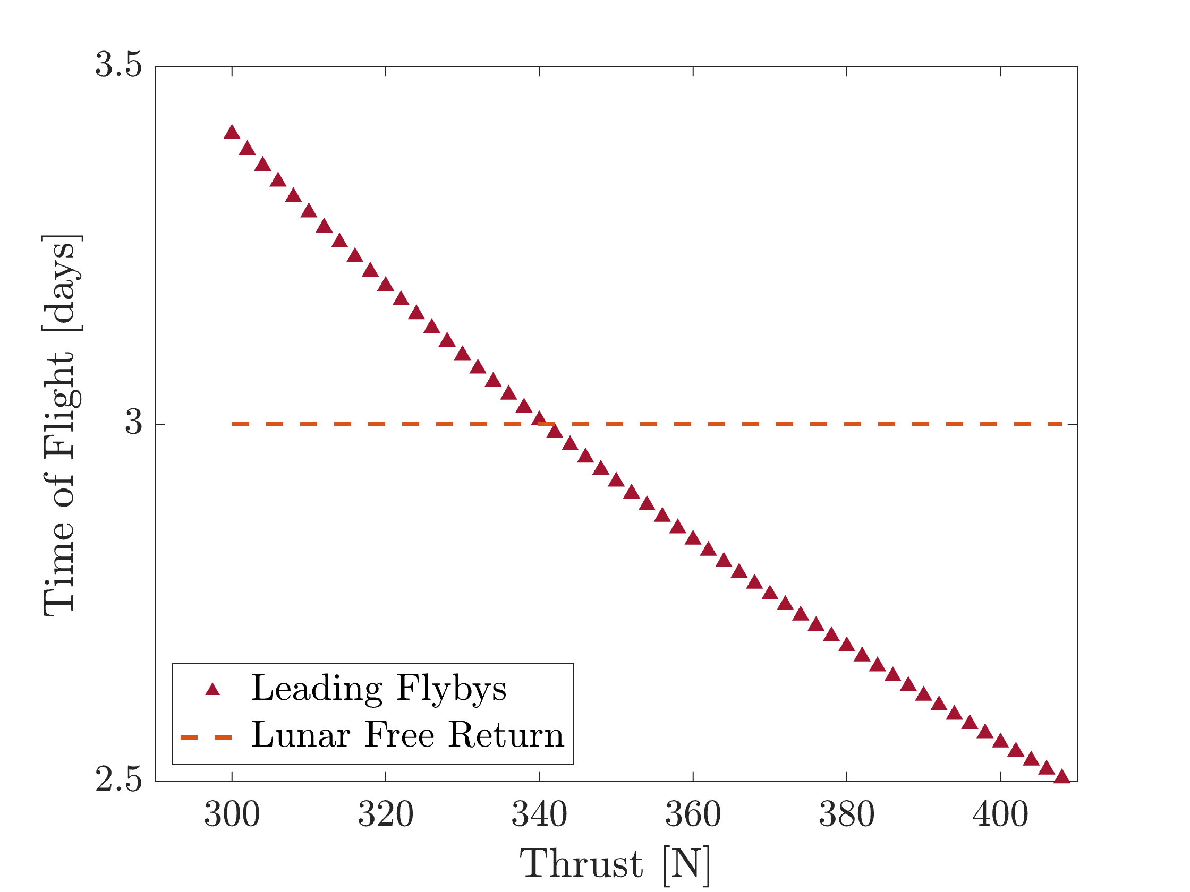
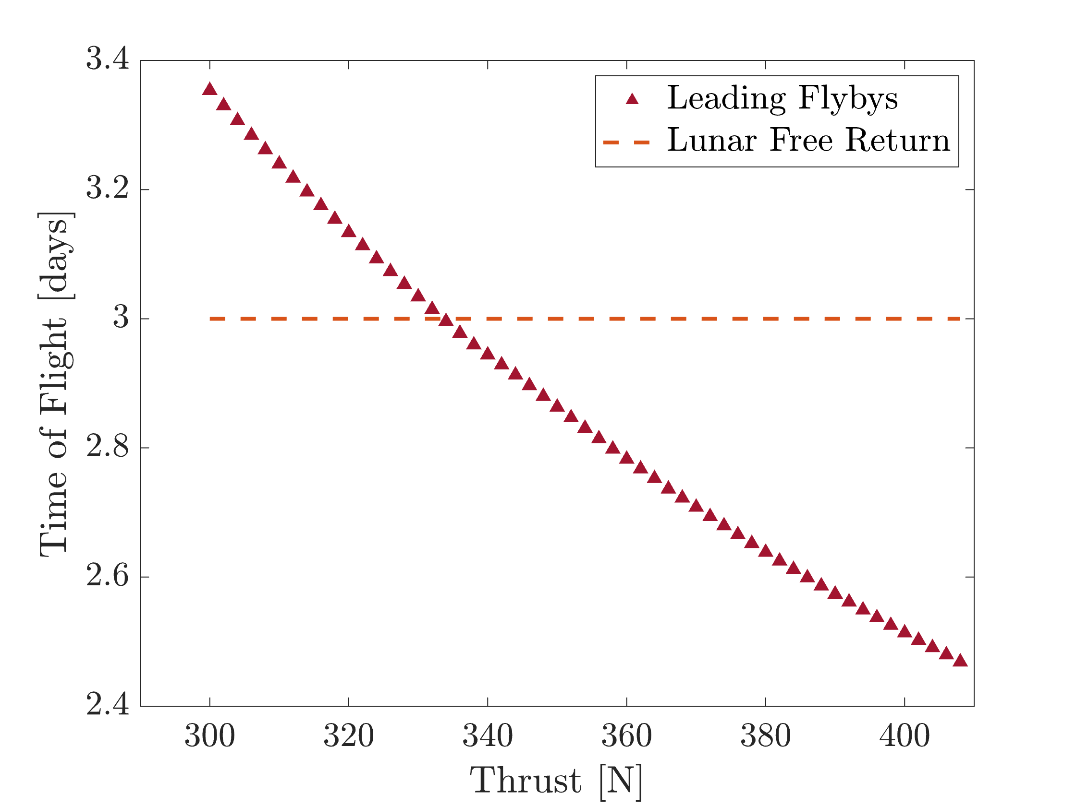
Time of Flight
Case Study 1
Case Study 2
Notes:
1) Discuss how TOF is calculated in both cases
- Deterministic in C.S I

Slide 16
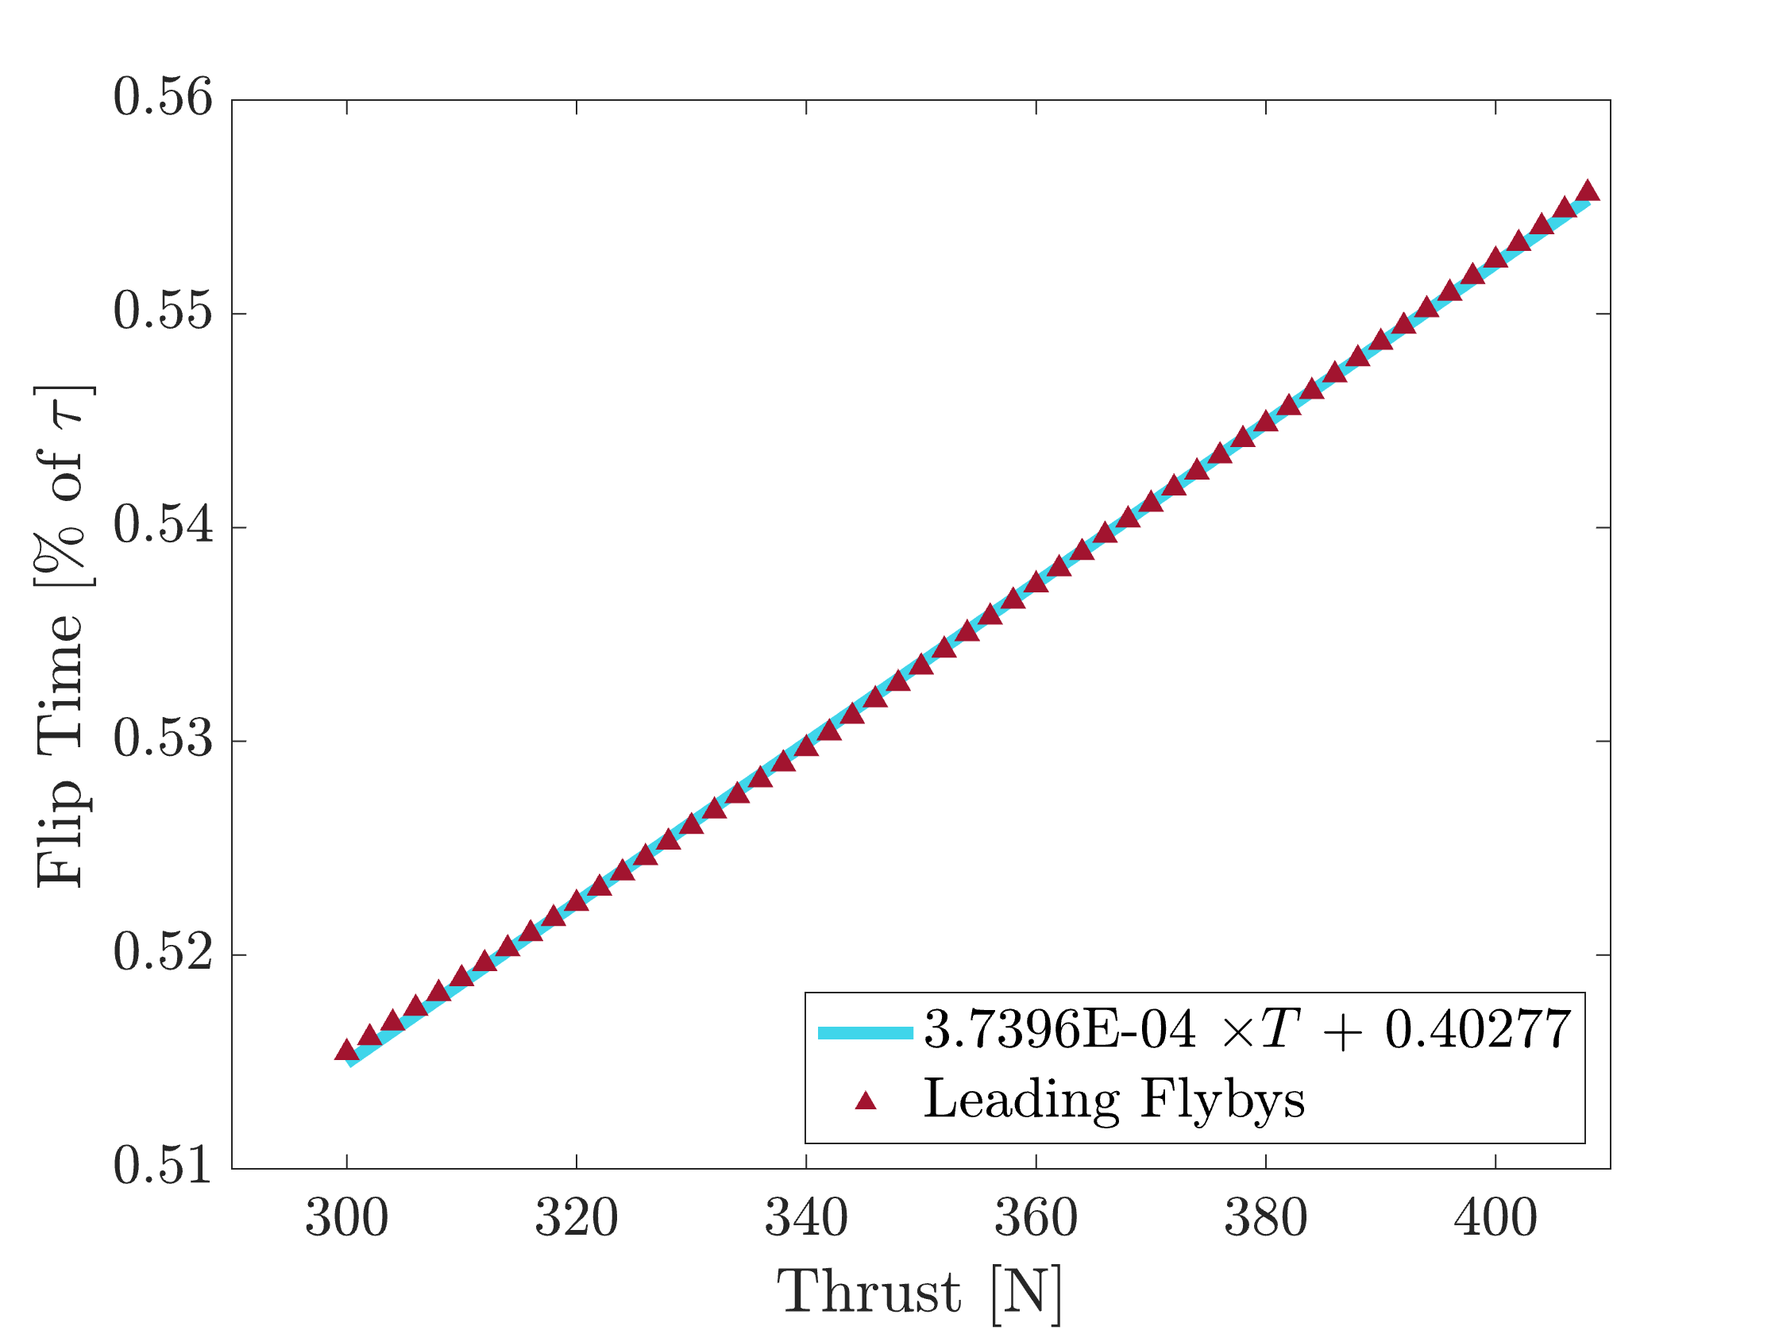
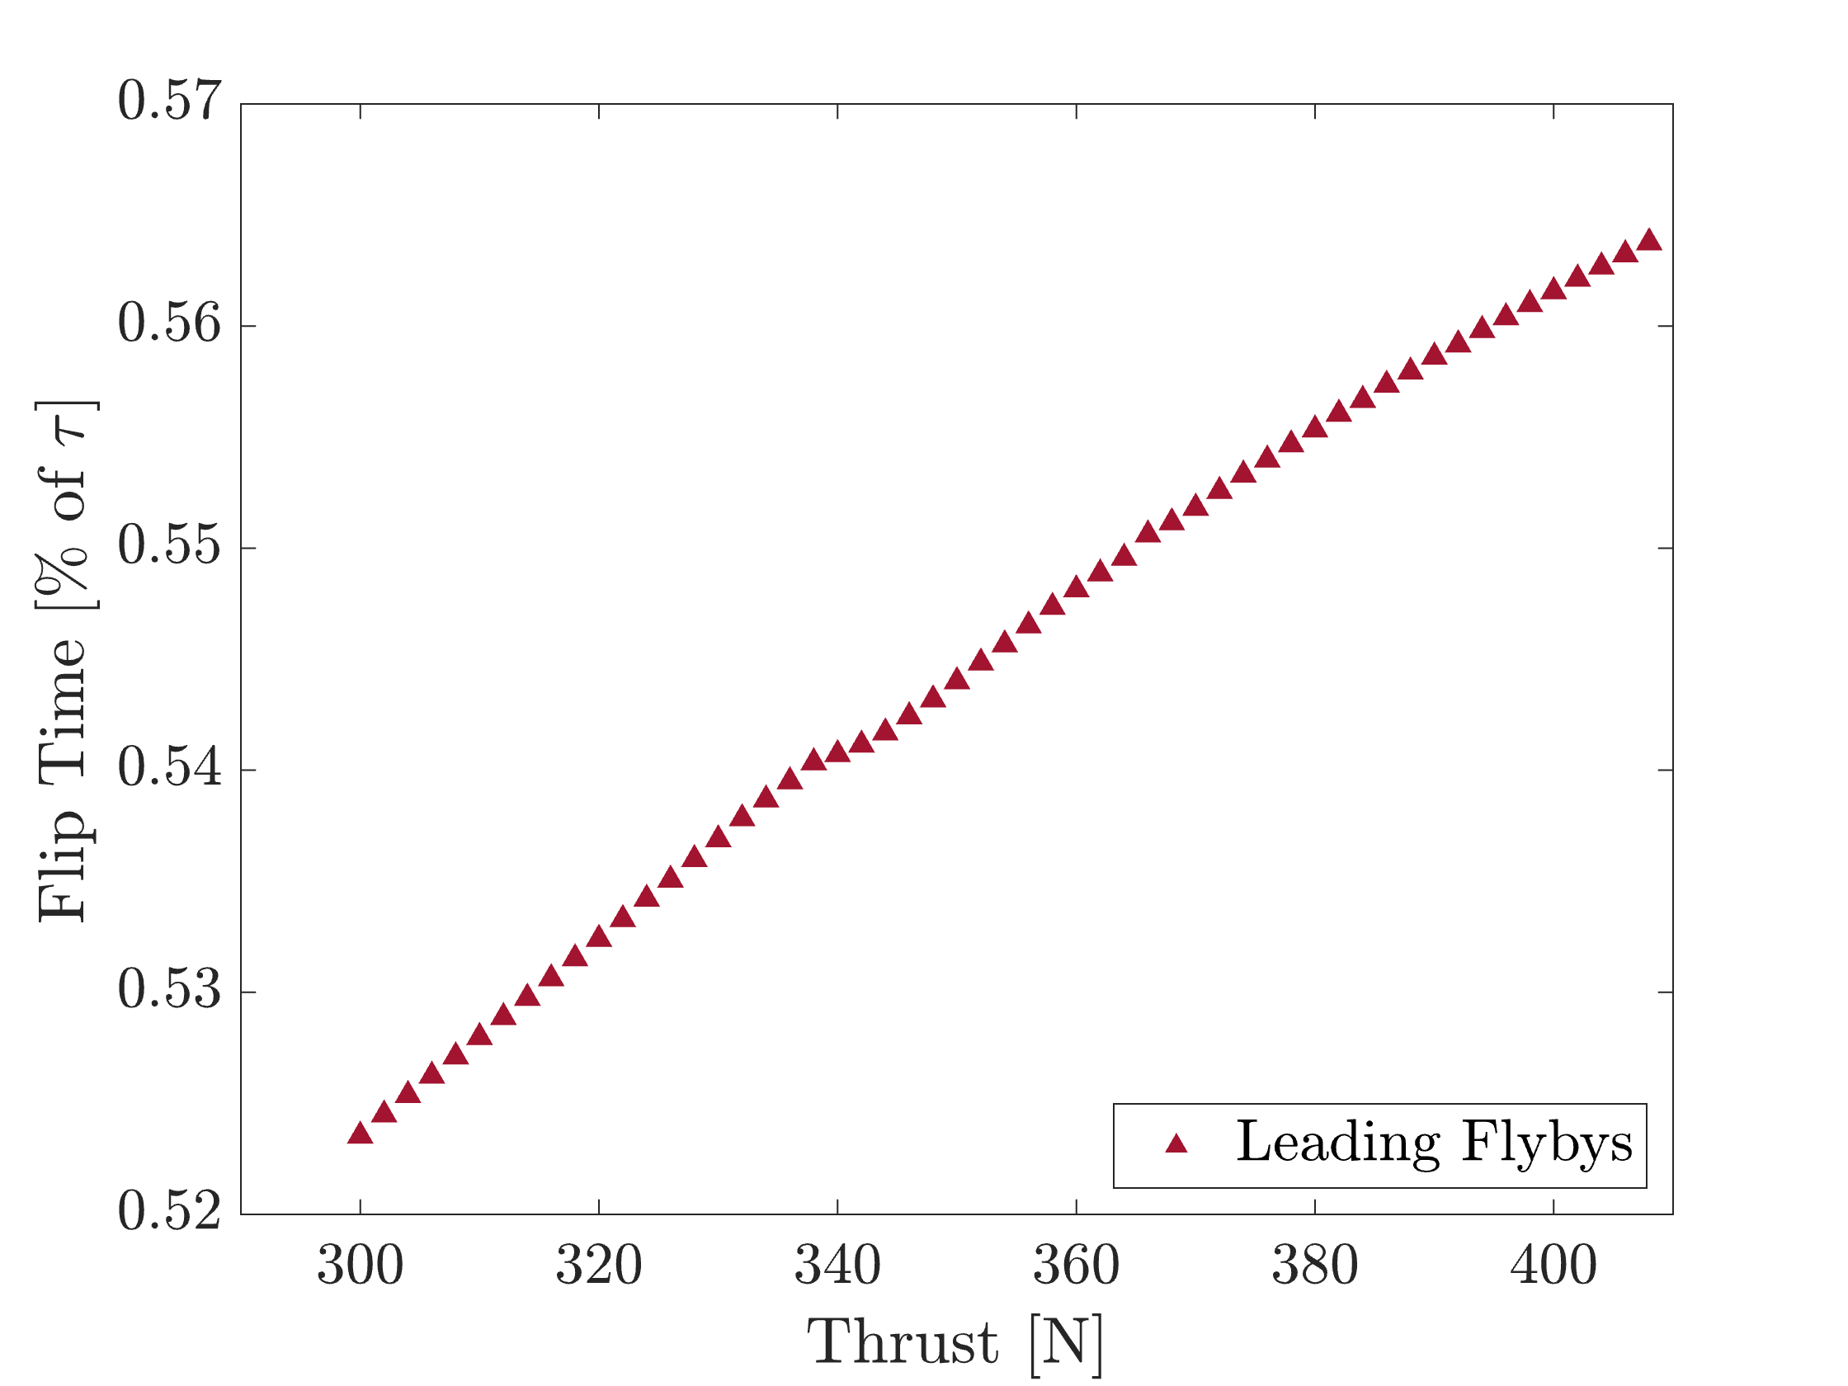
Flip Time Percentage
Case Study 1
Case Study 2
Notes:
1) Talk abt the theoretical first, aka 50% to >50%
2) Linear
- Helpful in local estimations
3) CS II
- Not linear bc of undeterministic TOF

Slide 17
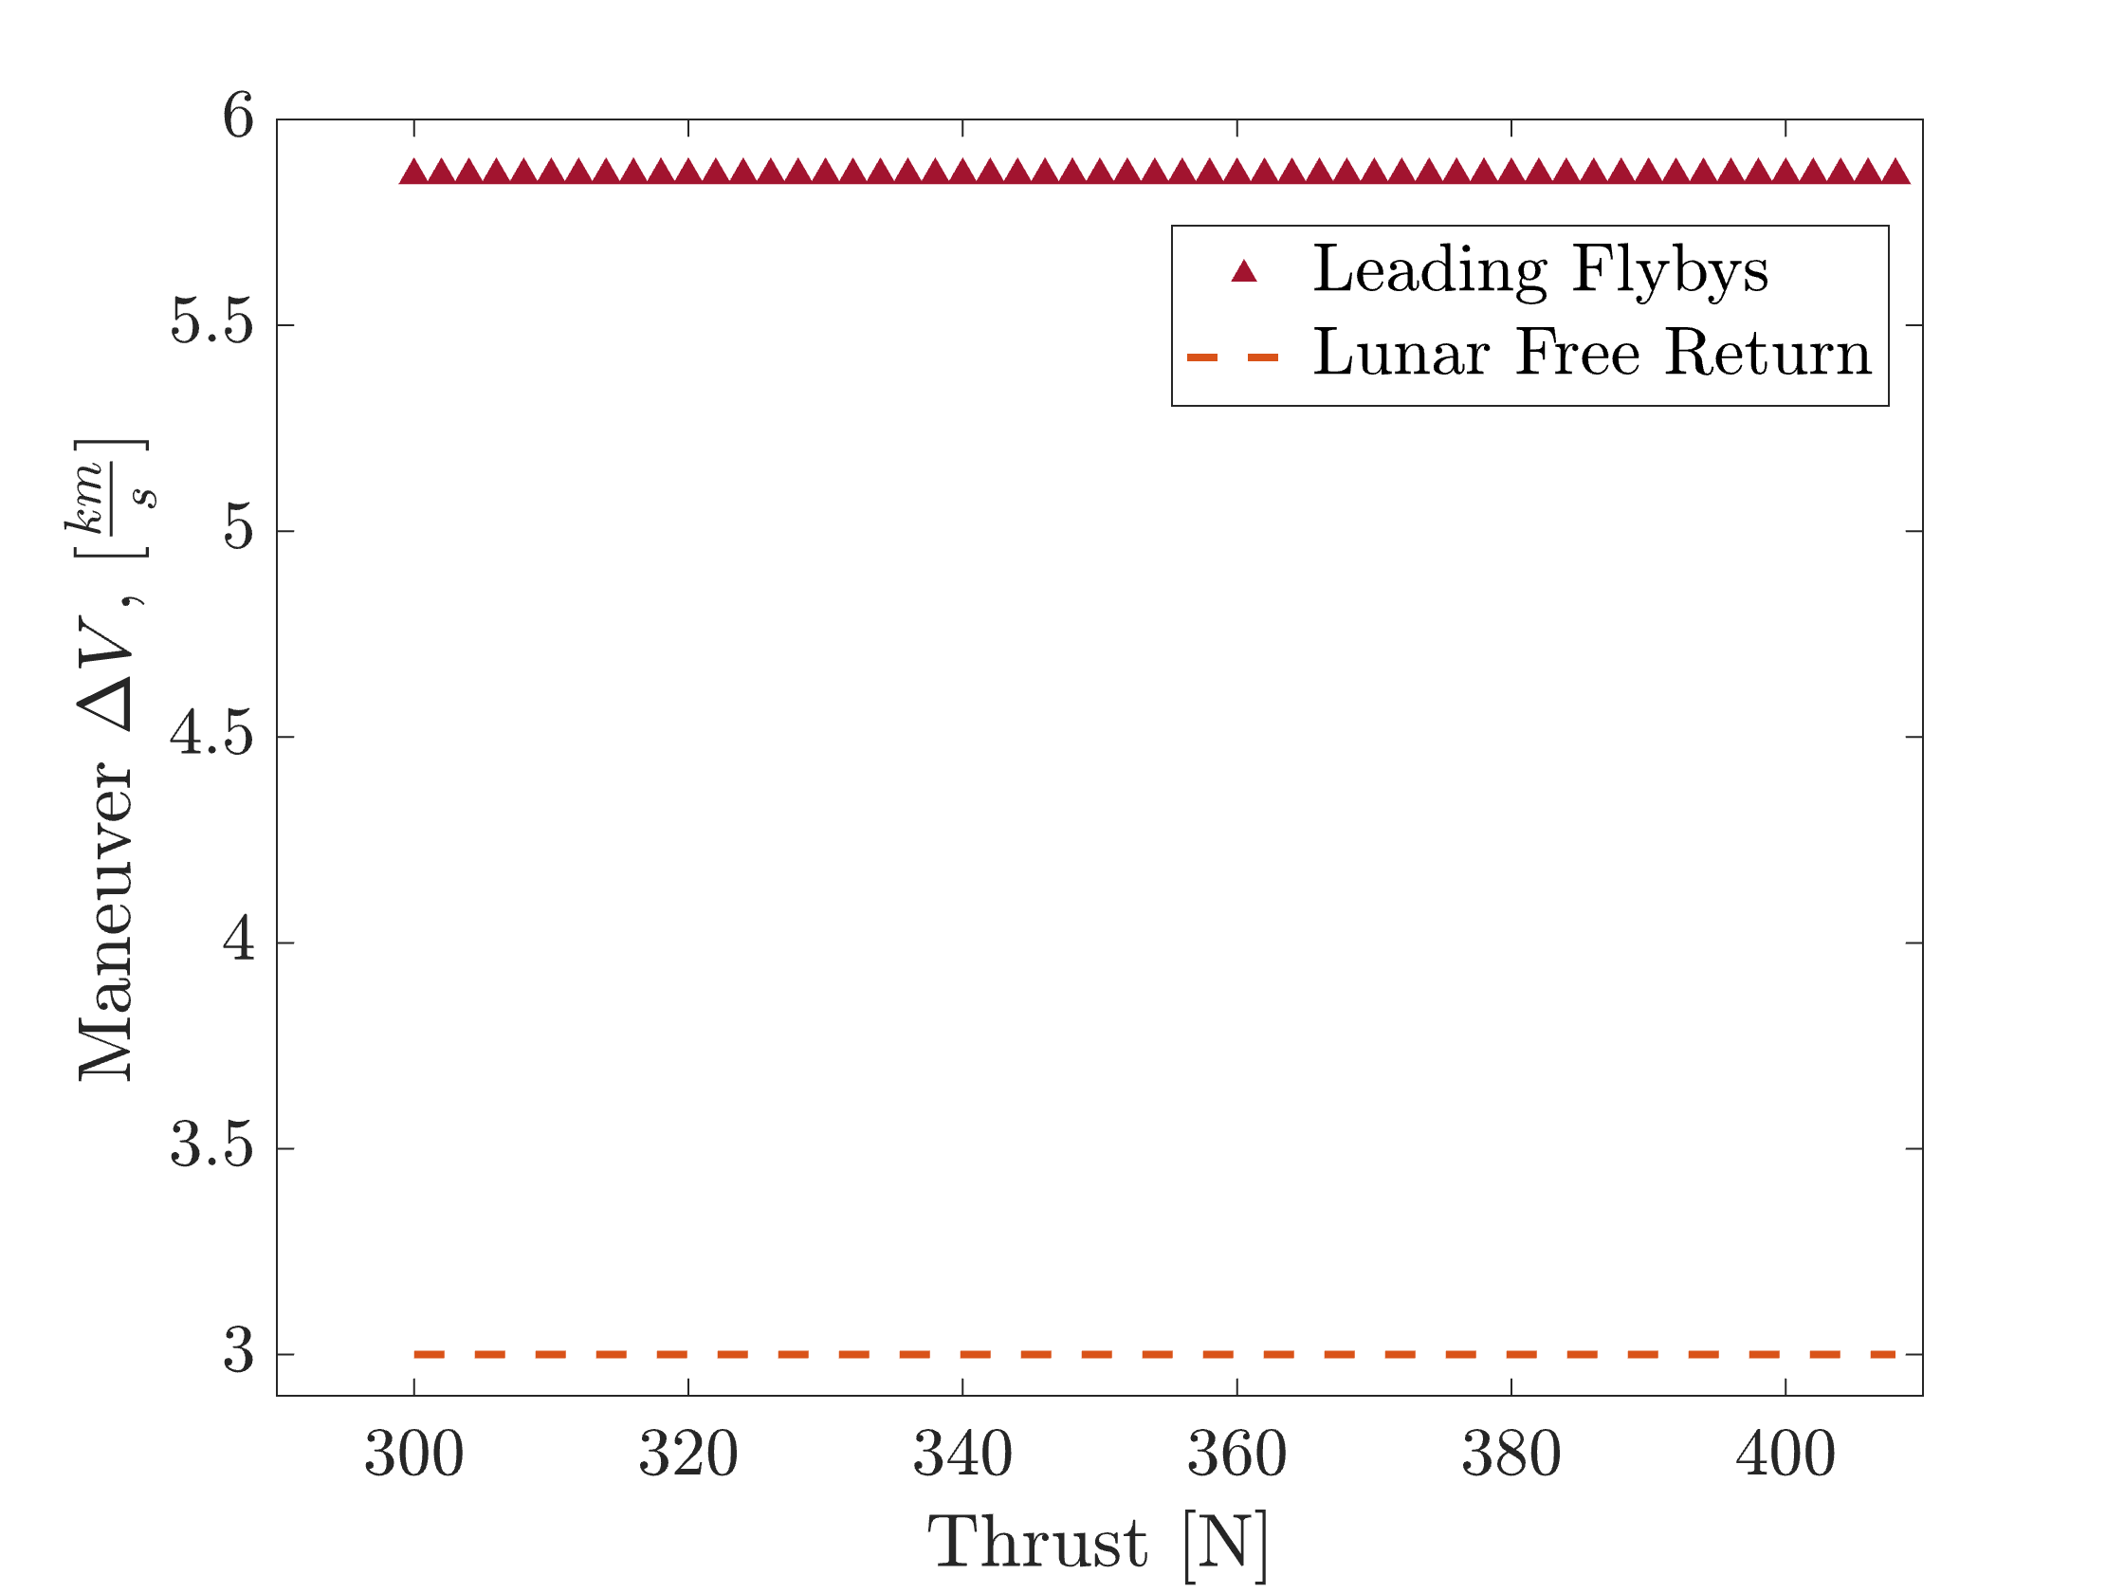
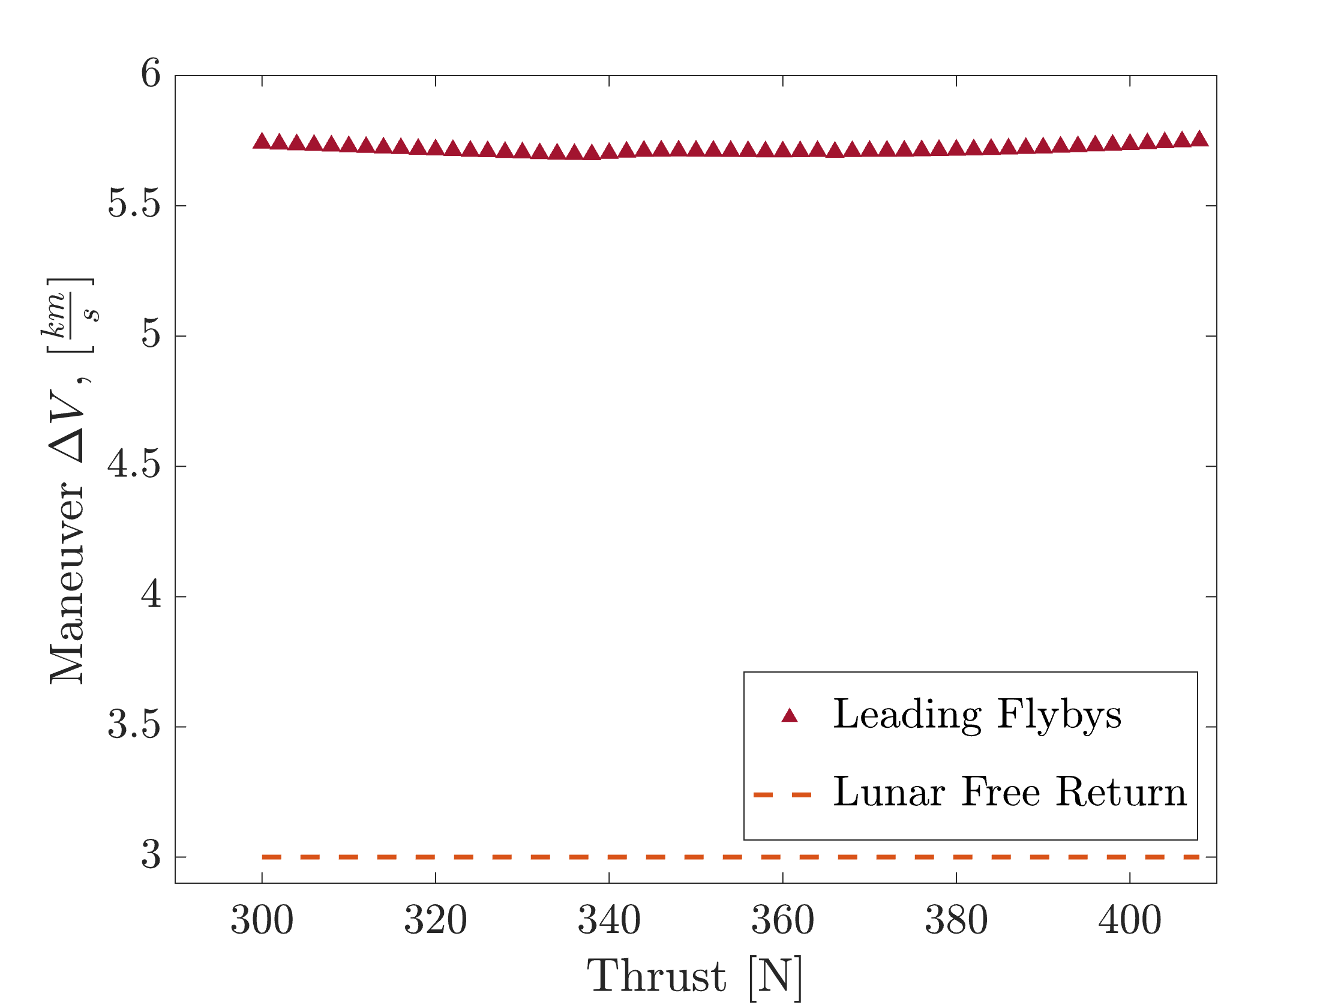
Maneuver ∆V
Case Study 1
Case Study 2

Slide 18
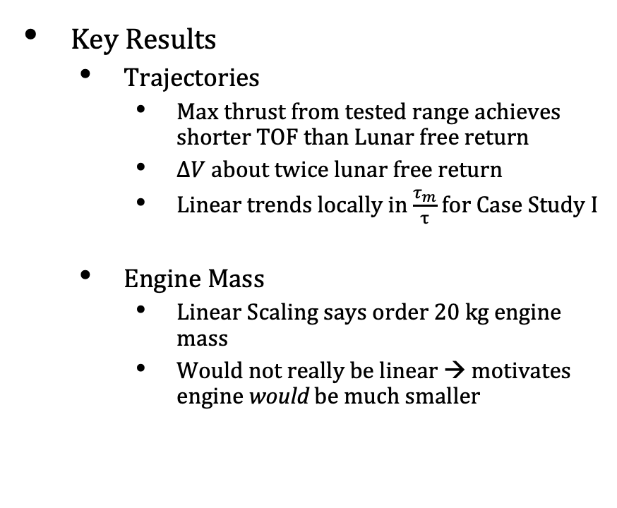
Results
Key Results
Trajectories
Max thrust from tested range achieves shorter TOF than Lunar free return
$ΔV$ about twice lunar free return
Linear trends locally in $\frac{τ_{m}}{τ}$ for Case Study I
Engine Mass
Linear Scaling says order 20 kg engine mass
Would not really be linear → motivates engine would be much smaller
Spacecraft
$$r_{s\backslash m}$$
$$r_{s\backslash e}$$
Moon
$${\hat{e}}_{2}$$
Earth
$$r_{m\backslash e}$$
$${\hat{e}}_{1}$$

Slide 19
Conclusion
Turn and Burn offers a new operational paradigm for NTP technology
The inherent benefits of running the reactor continuously could also include providing more power to the other systems of the spacecraft.
Order of magnitude smaller NTP engine
Erik D. Payton
edp48@cornell.edu
References
[1] Clark, A. C., 1986
[2] Harnack, C , 2023.
[3] Duchek, M. E., 2023.
[4] Bowman, A., 2024
[5]Lagarias et al, 1998

Slide 20
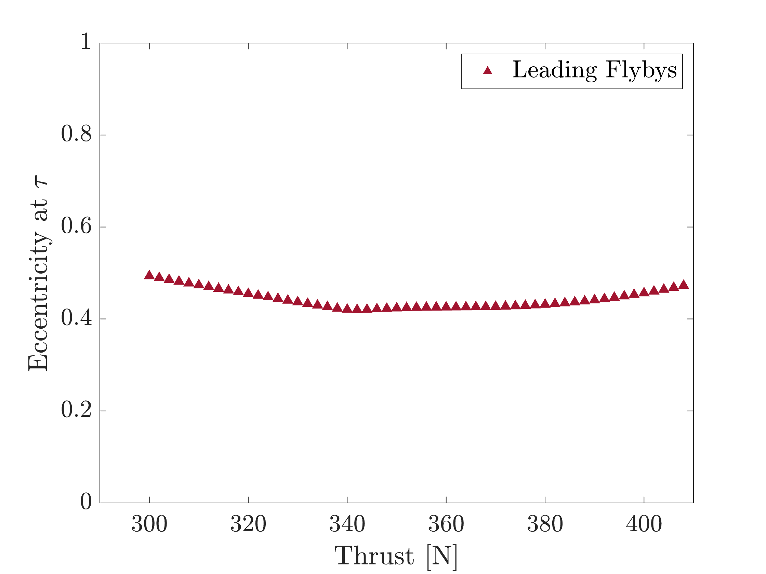
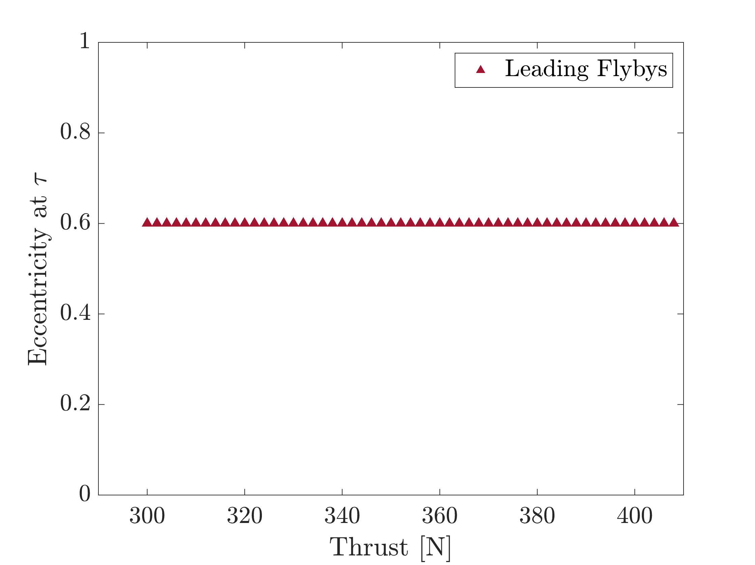
Final Eccentricity
Case Study 1
Case Study 2

Slide 21
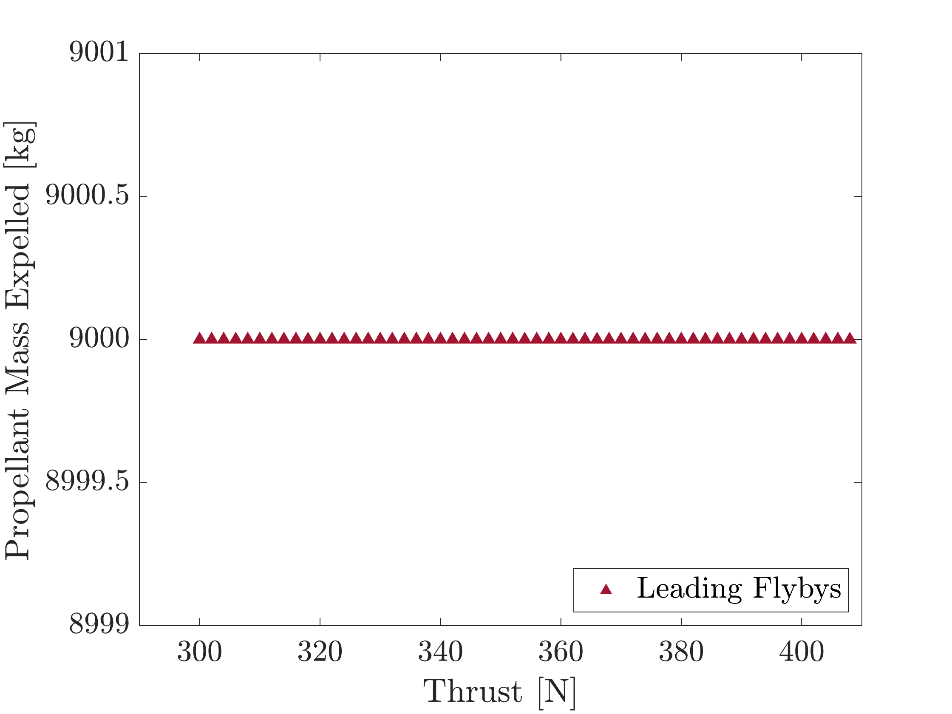
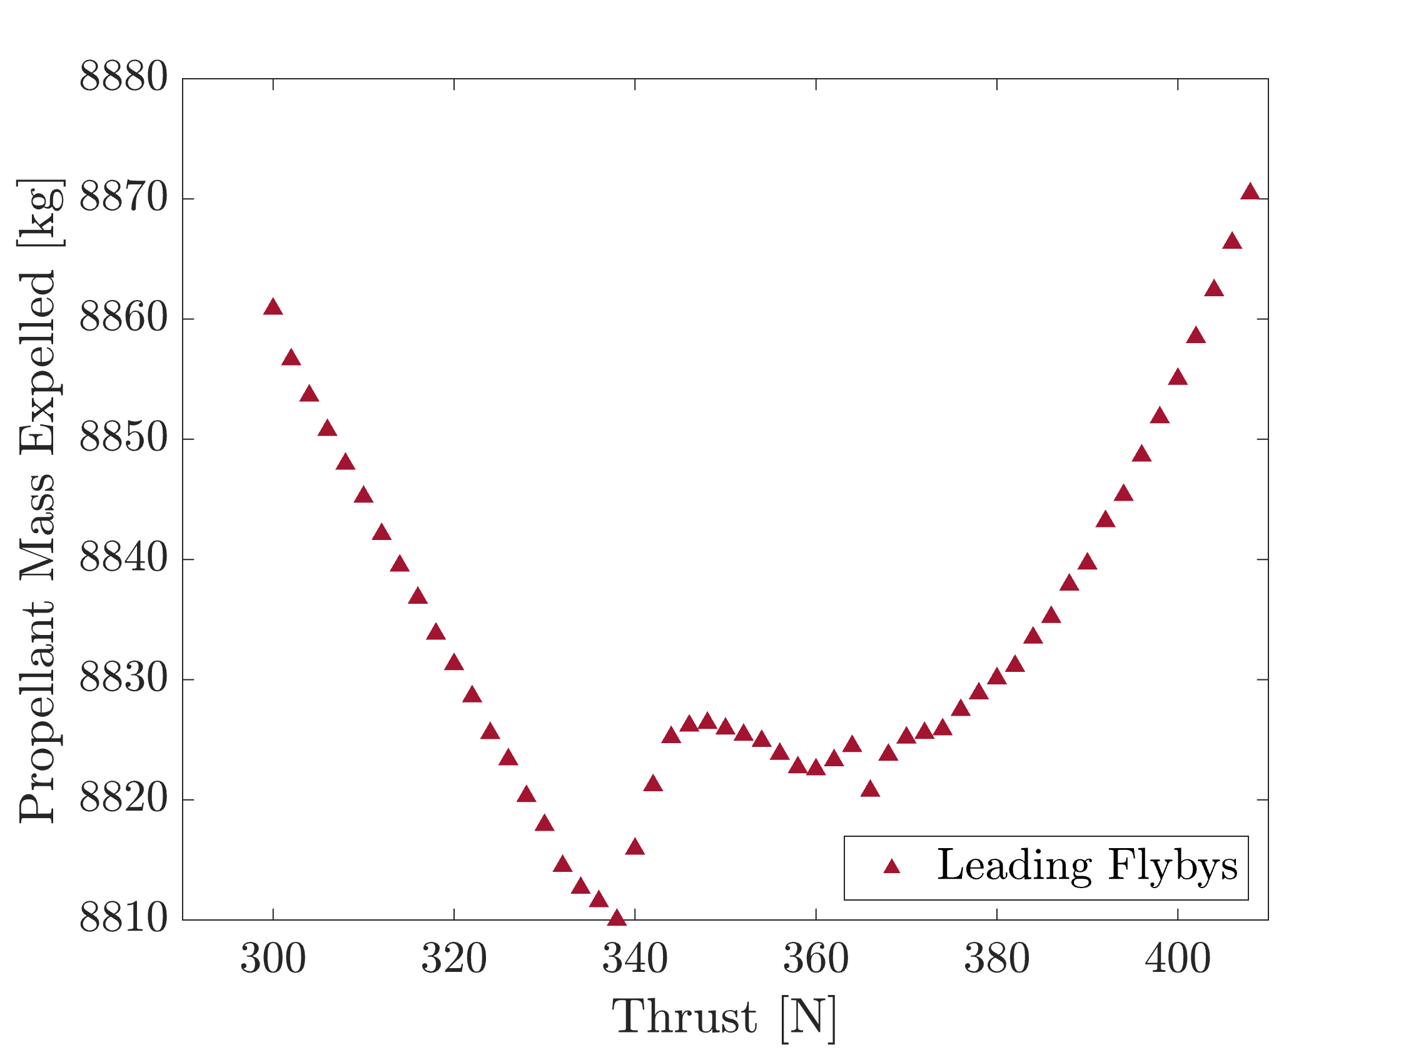
Propellent Mass Consumption
Case Study 1
Case Study 2

Slide 22
Backup
Analytical Expressions for Turn and Burn Maneuver
Hur, D., “Turn and Burn Closed Form Report (Cornell University internal document),” , 2023.

Slide 23
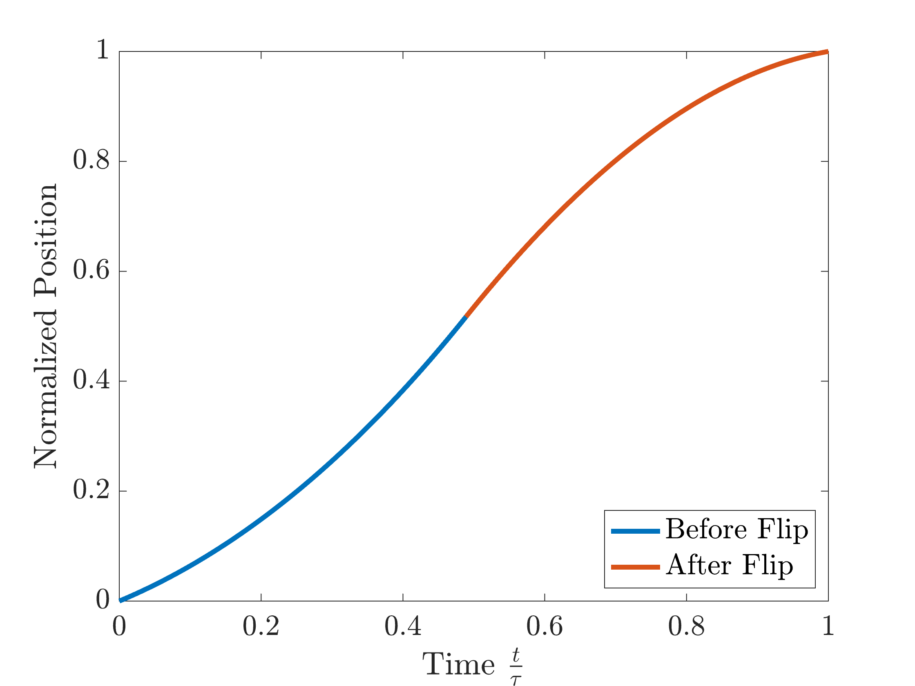
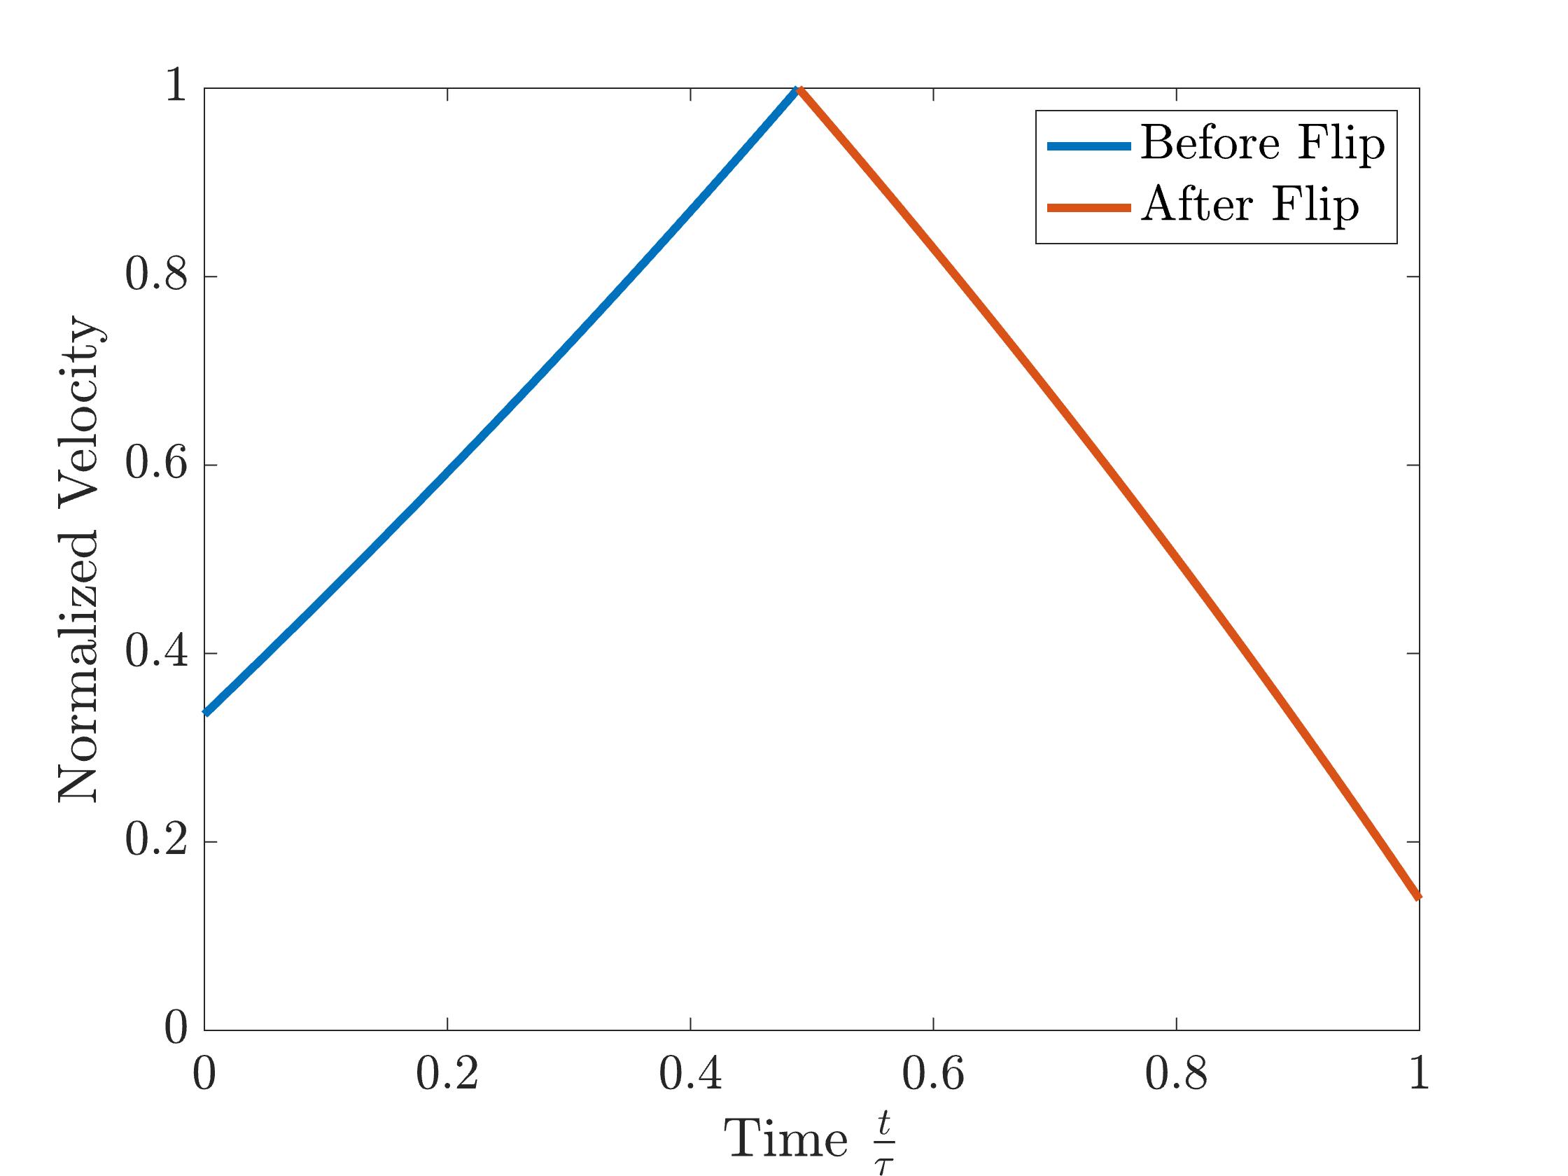
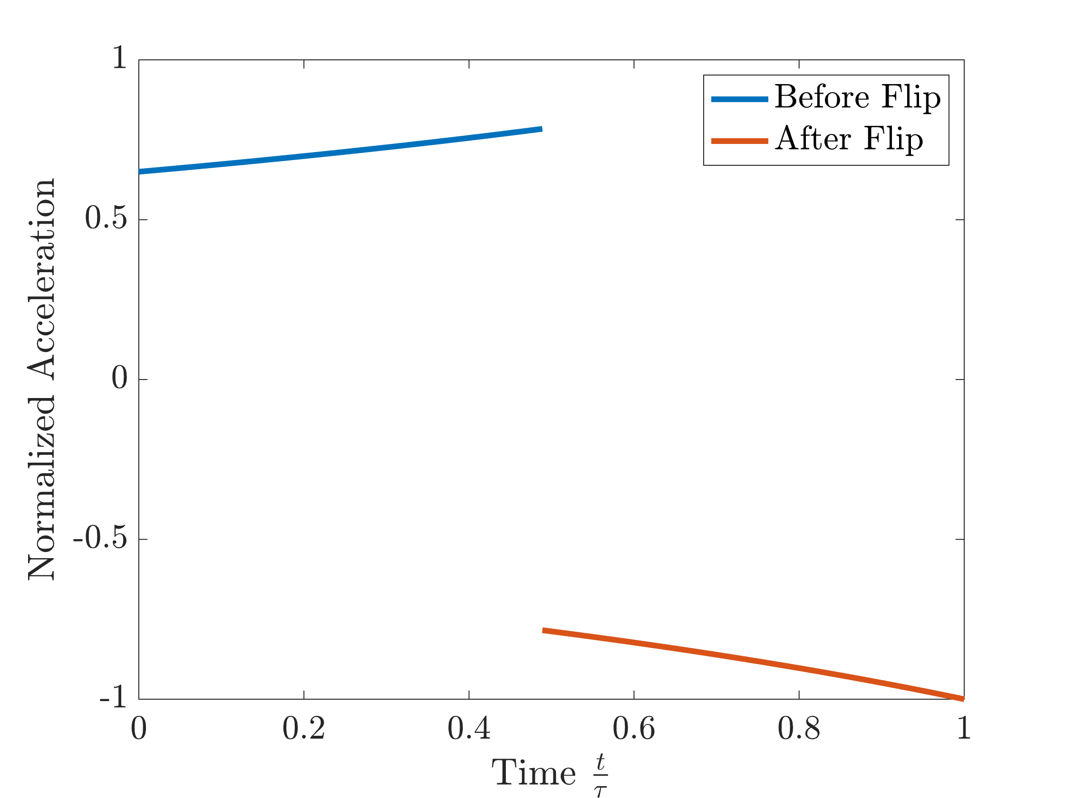
Backup

Slide 24
Backup: Engine Mass Scaling
Constant of Specific Technology
Want half of this
Must also be halved
RHS of all Equations is constant, given constant stagnation properties, and will be constant as well
Constants of these Equations:
All Stagnation Properties
Mach Number
Constant Ratio

Slide 25
Backup: Engine Mass Scaling
Hoop Stress will be constant
Know this is halved
Must also be halved

Slide 26
Backup: Engine Mass Scaling
Cylindrical Shell Volume formula
With both t and r* scaling as the whole volume and therefore mass is simply halved, thus implying a simple linear scaling
Notes:
1/rt(2)*(1/rt(2) = ½ means linaer

Slide 27
Backup
Final Conditions:
a: 9.05e6 km
e: 0.472
Omega: 0 rad
I: 0 rad
omega: 0.5281 rad
Notes:
1/rt(2)*(1/rt(2) = ½ means linaer

